Slide 1
Introduction to Sociology
The study of social behavior and the organization of human society

Slide 2
Sociology is
the study of society. Sociology is a very broad discipline that examines how humans interact with each other and how human behavior is shaped by social structures (groups, communities, organizations), social categories (age, sex, class, race, etc.), and social institutions (politics, religion, education, etc.).
The basic foundation of sociology is the belief that a person's attitudes, actions, and opportunities are shaped by all of these aspects of society.

Slide 3
there are four key questions at the heart of sociology that allow us to see the connections between everyday life and social structure and forces.
1. What are people doing with each other?
2. What are their relationships to each other?
3. How are these relationships organized in institutions?
4. What are the collective ideas that move men and institutions?

Slide 4

When sociologists look at the world and try to understand why things are the way they are, we look for relationships, and not just those between people. We look for relationships between individuals and the social groups they might relate to or be identified with, like race, class, gender, sexuality, and nationality, among others; connections between individuals and the communities they live in or affiliate with; and, relationships between individuals and institutions, like media, religion, family, and law enforcement.

Slide 5
Sociology disciplines
Globalization. The sociology of globalization focuses on the economic, political, and cultural aspects and implications of a globally integrated society.
Race And Ethnicity. The sociology of race and ethnicity examines the social, political, and economic relations between races and ethnicities at all levels of society.

Slide 6
Sociology disciplines cont’d
Family. The sociology of family examines things such as marriage, divorce, child rearing, and domestic abuse.
Social Inequality. The study of social inequality examines the unequal distribution of power, privilege, and prestige in society. These sociologists study differences and inequalities in social class, race, and gender.

Slide 7
Sociology disciplines cont’d
Work And Industry. The sociology of work concerns the implications of technological change, globalization, labor markets, work organization, managerial practices, and employment relations.
Education. The sociology of education is the study of how educational institutions determine social structures and experiences.
Religion. The sociology of religion concerns the practice, history, development, and roles of religion in society.

Slide 8

The Origins (Evolution) of Sociology
Sociology originated from and was influenced by the Industrial Revolution during the early nineteenth century= changes in Europe (rise of factory based industrial economy, growth of cities & democracy). This led to an awareness of society!

Slide 9
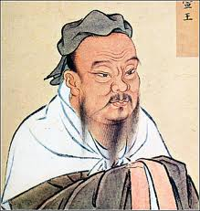
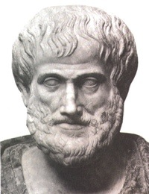
Philosophers: Confucius, Plato, Aristotle, Marcus Aurelius, Galileo, Newton, Shakespeare, Hobbes, Karl Marx

Slide 10
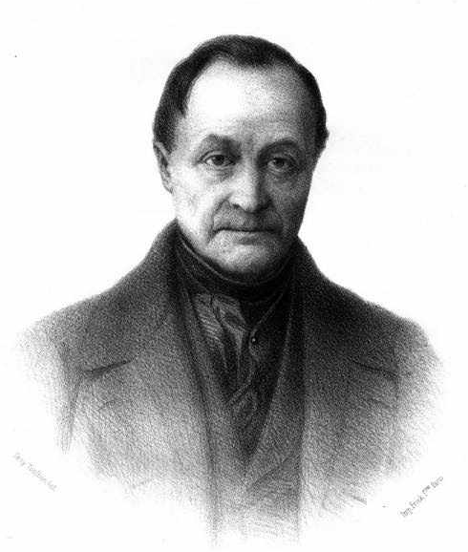
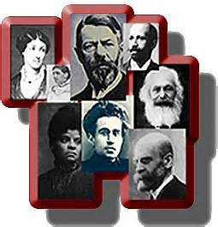
The origins of Sociology
There are seven major founders of sociology: August Comte, W.E.B. Du Bois, Emile Durkheim, Harriet Martineau, Karl Marx, Herbert Spencer, and Max Weber.
August Comte is thought of as the "Father of Sociology" as he coined the term sociology in 1838. He believed that society should be understood and studied as it was, rather than what it ought to be.
1838: Auguste Comte (French) coined name based on science/research

Slide 11
Harriet Martineau was a British scholar and writer who wrote prolifically about the relationship between politics, morals, and society, as well as sexism and gender roles.
Karl Marx (1818-1883)
Karl Marx was a German philosopher and economist. In 1848, he and Friedrich Engels (1820–1895) coauthored the Communist Manifesto. This book is one of the most influential political manuscripts in history.
Marx, Spencer, Durkheim, and Weber helped define and develop sociology as a science and discipline,

Slide 12
Applications of sociology
1. Teaching
2. Social research
3. Social work
4. Professions—medicine, law, engineering, business, etc.
5. Industry
6. Rural and urban planning
7. Public administration—civil services
8. Policy making
9. Business consultancy
10. Politics
11. Architecture
12. Child welfare and health care
15. Military intelligence and military
16. Entrepreneurship
17. International relations
18. Criminal justice

Slide 13
Profession and Ethics
Introduction
A Profession is a vocation founded upon specialized educational training, the purpose of which is to supply disinterested counsel and service to others, for a direct and definite compensation, wholly apart from expectation of other business gain.
A Professional is a member of a vocation founded upon specialized educational training.
Similarly, Professionalism is the standing, practice, or methods of a professional, as distinguished from an amateur.

Slide 14
Profession and Ethics
Profession is the vocation (feeling for particular occupation) founded on specialized educational training.
- Profession the systematic knowledge acquired through is those occupation that needs special skill and training.
- Profession delivers services to the society that helps to achieve progressive social change.
A profession can be defined as a field of skill and knowledge which is practiced by a person who has acquired such skill and knowledge through specialized training and education.
Profession is synonym to job or occupation.
Profession helps providing specialized type of service for a needy person or community.

Slide 15
Charactersistics of Profession
Systematic knowledge and skills
Authenticity of knowledge and skill/ specialized types of services
Honored and respected in society
It is a public property and matter of public evaluation
Bound by code and ethics
Every profession have some culture that is similar to the other person of same profession and different from different profession.

Slide 16
Ethics,Code of Ethics and Engineering Ethics
Sociologist Raymond Baumhart asked business people, "What does Ethics mean to you?" Among their replies were the following:
  "Ethics has to do with what my feelings tell me is right or wrong.“
  "Ethics has to do with my religious beliefs.“
  "Being ethical is doing what the law requires.“
  "Ethics consists of the standards of behavior our society accepts.“
  "I don't know what the word means."
These replies might be typical of our own. The meaning of "ethics" is hard to pin down, and the views many people have about ethics are shaky.

Slide 17
What, then, is Ethics?
Ethics means two things:
  First, ethics refers to well-founded standards of right and wrong that prescribe what humans ought to do, usually in terms of rights, obligations, benefits to society, fairness, or specific virtues
  Secondly, ethics refers to the study and development of one's ethical standards. Feelings, laws, and social norms can deviate from what is ethical

Slide 18
Ethics
Ethics, also known as moral philosophy is a branch of philosophy that addresses questions about morality—that is, concepts such as good and evil, right and wrong, virtue and vice, justice, etc.
A set of principles of right conduct.
A theory or a system of moral values
Engineering Ethics mean the rules or standards governing the conduct of a person or the members of a engineering profession. It is the field of applied ethics which examines and sets standards for engineers' obligations to the public, their clients, employers and the profession.

Slide 19
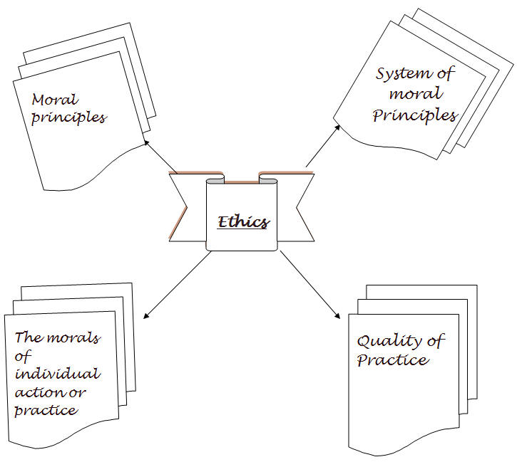

Slide 20
Engineering Ethics
The field of applied ethics which examines and sets standards for engineers’ obligation to the Public, their Clients, Employers and Profession.
Ethical Approaches mostly influenced by whether the engineers are independently providing professional service or government service or production enterprises.

Slide 21
Fundamental Ethical Values for
Code of Ethics
Protection of life and safeguarding people
Sustainable management and care for the environment
Community well being.
Professionalism, integrity and competence
Sustaining engineering knowledge.

Slide 22
Importance of “Code of ethics” & “Guidelines for Professional Practice”
1. Code of ethics governs the conduct of all practitioner
2. It ensure that engineers practice within their expertise, they do so in a fair and ethical manner and they place good of society above their personnel gain.
3. This is a means by which engineers govern (direct) themselves
4. It is a privilege earned over the years through knowledge, experience and trust.

Slide 23
Fundamental Ethics (Canons) of IT Professional
IT Professional shall perform services only in areas of their competence.
IT Professional shall issue public statements only in an objective and truthful manner.
IT Professional shall act in professional matters for each employer or client as faithful agents or trustees, and shall avoid conflicts of interest.
IT Professional shall build their professional reputation on the merit of their services and shall not compete unfairly with others.

Slide 24
Fundamental Ethics (Canons) of IT Professional
IT Professional shall act in such a manner as to uphold and enhance the honor, integrity, and dignity of the engineering profession and shall act with zero-tolerance for bribery, fraud, and corruption.
IT Professional shall continue their professional development throughout their careers, and shall provide opportunities for the professional development of those engineers under their supervision.“
IT Professional shall not sign upon any documents, which are not prepared by him or under his direct supervision.

Slide 25
Other Ethics
Relationships with clients, consultants, competitors, and contractors
Ensuring legal compliance by clients,client's contractors, and others
  Conflict of interest
  Bribery, which also may include: Gifts, meals, services, and entertainment
Treatment of confidential or proprietary information
Consideration of the employer’s assets
Outside employment/activities (Moonlighting)

Slide 26

Morals
  It is founded on the fundamental principles of right conduct rather than on legalities, enactment, or custom. It means conforming to the rules of right conduct acting on the mind, feelings, will, or character.

Slide 27
Values, Morals & Ethics
  Values are the rules by which we make decisions about right and wrong, should and shouldn't, good and bad.
  Morals have a greater social element to values and tend to have a very broad acceptance. Morals are far more about good and bad than other values. We thus judge others more strongly on morals than values. A person can be described as immoral, yet there is no word for them not following values.

Slide 28
Values, Morals & Ethics
  You can have professional ethics, but you seldom hear about professional morals. Ethics tend to be codified into a formal system or set of rules which are explicitly adopted by a group of people. Ethics are thus internally defined and adopted, whilst morals tend to be externally imposed on other people.

Slide 29
Characteristics of Ethical Problems
Ethical problems in managements are complex, as most ethical decisions have-
Extended consequences
Multiple alternatives
Mixed outcomes
Uncertain outcomes
Personal Implications

Slide 30

INTRODUCTION
ICT Ethics, Security & Policy Issues
Policy = Acceptable Use guidelines
Security =
Anti-theft, Anti-virus, Anti-Hacker, Anti-fraud measures
Ethics = The “Rights” & “Wrongs” of ICT usage.

Slide 31
DEFINITION
Definition: Ethic, ethical, ethics
Ethics is concerned with issues of value, such as judgments about what constitutes "good" or "bad" behavior in any given context. Ethics are the standards, values, morals, principles, etc., which guide one's decisions or actions.
ICT Ethics relate to the standards of conduct governing individual, institution’s societies’ & or international use of information & communication technology

Slide 32
DOMAINS OF ICT ETHICS
Commercial & Legal Issues
Expression
Privacy Issues
Social Justice / Accessibility
Computer Abuse
Intellectual Property
Moral Responsibility
Risks

Slide 33
DETAILS OF ICT ETHICS
COMMERCIAL / LEGAL ISSUES –
concern Fraud, Free-trade, Gambling, Anticompetitive Practices, etc.
ICT standards governing commercial & legal issues aim to suppress dishonest business practices and to protect and encourage fair competition
EXPRESSION –
Concerns, Free Speech, Netiquette (polite-use conventions), etc.
ICT related standards aim to control(among other things) hate motivated or indecent communication, whilst protecting free-speech rights.

Slide 34
DETAILS OF ICT ETHICS
PRIVACY –
Concerns E-mail Privacy, Anonymity, Spamming, encryption, database or personal information Privacy etc.
Ethical standards protect personal & commercial information such as login & password info, credit card and account information and government and commercial databases. It also controls unwanted internet mail and ads (Spam).

Slide 35
DETAILS OF ICT ETHICS
SOCIAL JUSTICE –
Social Justice relates to The Digital Divide (unequal ICT access), Accessibility for students with special needs , etc.
Ethical standards relate to making ICT available and accessible to all peoples, including the disabled and the deprived.
Accessibility needs to be kept in mind during curriculum design(in educational contexts), in order to maximize the capabilities of the technology

Slide 36
DETAILS OF ICT ETHICS
INTELLECTUAL PROPERTY – concerns
Intellectual Content, Student Authenticity, Software Piracy. Patents & Copyright Law, Electronic Copyright etc.
ICT Ethical standards aim to control plagiarism, student identity fraud, and the use of copyrighted material, etc.
MORAL RESPONSIBILITY –
Concerns individual action such as Whistle-blowing (exposing ethical violations) and personal adherence to ethical codes. Ethical standards include a personal moral dimension.

Slide 37
DETAILS OF ICT ETHICS
RISKS –
Risk faced by ICT users relate to username thefts, Computer hardware & Software Reliability, etc.
Related ICT Ethical standards govern Internet Service Providers (ISP), responsibility to protect client information and the quality of computer hardware and software.
COMPUTER ABUSE
Computer abuse includes Hacking, dissemination of software Worms, software Viruses, Trojan Horses (program that introduces viruses to computers), etc.
Related ethical standards aim to penalize violators.

